Slide 1
System Design Activities: From Objects to Subsystems
Brisaac Johnson, Alec Cromer, Evan Myers, Ian Neer, Dakota Nation, Kevin Mitchell, Darius Fiallo, Matthew Williams

Slide 2
6.4 System Design Activities: From Objects to Subsystems
System design consists of transforming the analysis model into the design model
Factors to consider: nonfunctional requirements described in the requirements analysis document

Slide 3
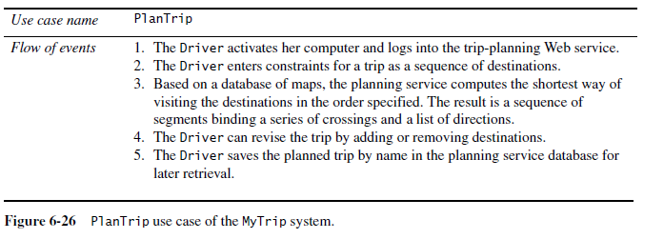
6.4.1 Starting Point: Analysis Model for a Route Planning System

Slide 4
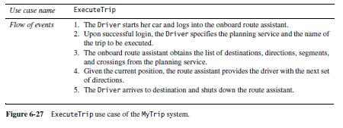
6.4.1 Starting Point: Analysis Model for a Route Planning System

Slide 5
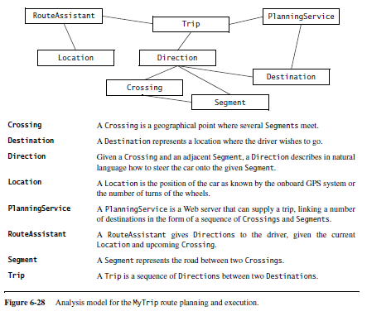

Slide 6
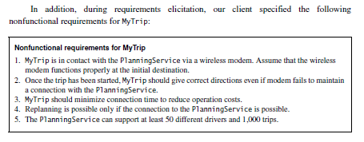

Slide 7
6.4.2 Identifying Design Goals
The definition of design goals is the first step of system design.
It identifies the qualities that our system should focus on.
Many design goals can be inferred from the nonfunctional requirements or from the application domain.
Some must be elicited from the client
These criteria are organized into five groups: performance, dependability, cost, maintenance, and end user criteria
Performance, dependability, and end user criteria are usually specified in the requirements or inferred from the application domain.
Cost and maintenance criteria are dictated by the customer and the supplier.

Slide 8
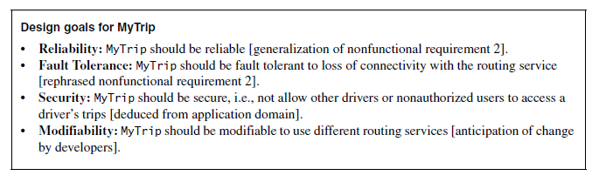
6.4.2 Identifying Design Goals

Slide 9
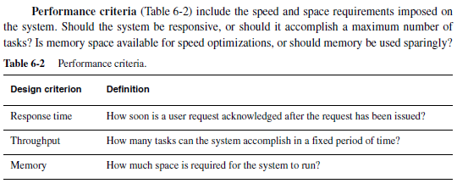
6.4.2 Identifying Design Goals

Slide 10
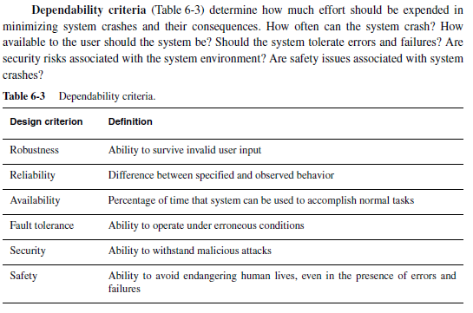

Slide 11
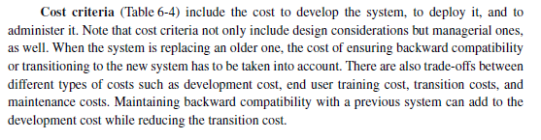
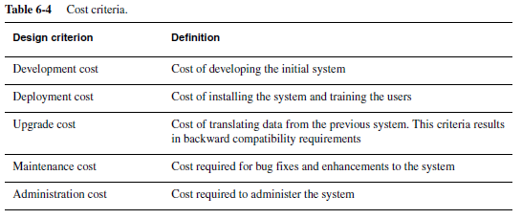

Slide 12
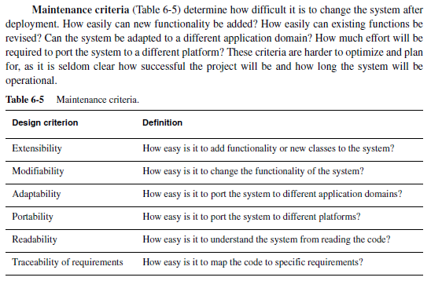

Slide 13

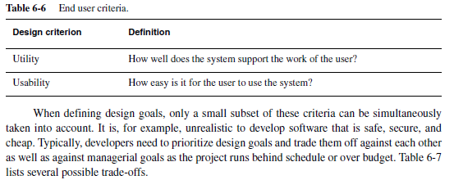

Slide 14
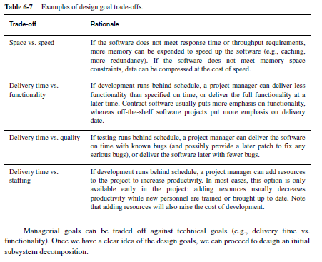

Slide 15
6.4.3 Identifying Subsystems
The initial subsystem decomposition should be derived from the functional requirements
Subsystem decomposition is constantly revised whenever new issues are addressed:
Several subsystems are merged into one subsystem
A complex subsystem is split into parts
Some subsystems are added to address new functionality.

Slide 16

6.4.3 Identifying Subsystems
Abbott’s heuristics
changes in design model during first iterations can be addressed with brainstorming
initial subsystem should be derived from functional requirements Some subsystems are added to address new functionality.
The Facade design pattern allows us to further reduce dependencies between classes by encapsulating a subsystem with a simple, unified interface.

Slide 17
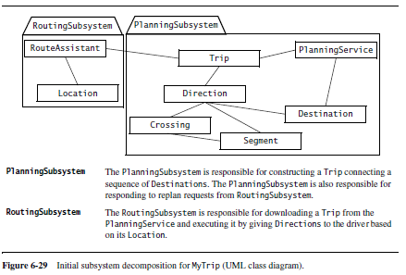

Slide 18
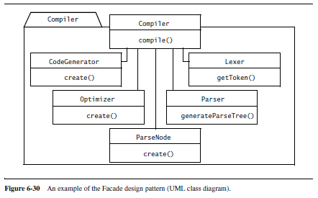
Subsystems identified during the initial subsystem decomposition often result from grouping several functionally related classes.
good candidates for the Facade design pattern and should be encapsulated under one class functionality.

